Slide 1


Slide 2


Slide 3
CSA Tech Talk
Presented by:
Todd Kruse, Team 3840
Chris Roadfeldt, Team 4607

Slide 4
Questions Answered
Who Are We?
What is CSA?
When should you contact a CSA?
How can you contact a CSA?
Firmware?
How to check versions
Loading firmware
How setup the RobotRIO
Imaging for LabView, Java, C++

Slide 5
Questions Answered
2017 Radio Setup
Configuration Utility
Driver Station Overview
Controls and debug help
Radio Configuration
Tips and Good Practices
Troubleshooting, things to be aware

Slide 6
Who we are?
Todd
2018 is 5th season with FIRST
Lead Electrical/Software Mentor for Team 3840
Robot Inspector
Lead C.S.A
Chris
4th Season with FIRST
Former Lead Controls Mentor, now Support Mentor for 4607
Robot Inspector
Lead C.S.A

Slide 7
What is a CSA?
The FIRST Control System Advisor is a volunteer who assists teams with Robot Control System-related issues. Works in collaboration with the FIRST Technical Advisor and/or Robot Inspectors, who may direct teams experiencing issues on the field or in the pits to the CSA for assistance.

Slide 8
What is a CSA?
Classic: Assist teams in correcting Robot Control System Issues such as those related to the roboRIO, support boards such as the Pneumatics Control Module, wiring, programming, sensors, driver station, and laptop-roboRIO interface
MN CSA: Assist teams on and off season with all aspects of robot controls. Eg; code language determination, training, 2nd opinions, etc…
Folks in the Orange Caps.

Slide 9
When should you contact a CSA?
Classic: At events for support of control issues.
MN CSA: Whenever you have controls related question. Can also assist with some drivetrain related questions. On or Off season.
Wear Orange Caps.

Slide 10
How can you contact a CSA?
Classic: Find the Orange Hats
MN CSA:
Email: firstmn.csa@gmail.com - also opens a trello ticket.
Slack: firstmncsa.slack.com – please request invite.
Twitter: @firstmncsa
Additional Resources:
First MN Website: http://mnfirst.org/first-community-resources/local-assistance/
First MN CSA Github: https://github.com/firstmncsa
First MN Google Drive: http://goo.gl/STtiAg

Slide 11
Updating your roboRIO firmware
Enter the address 172.22.11.2 in your browser's address bar and press enter.
roboRIO-####-FRC.local, where #### is your team number)
The embedded web server on the roboRIO requires using a browser which supports Silverlight
Note that Google Chrome has removed Silverlight support, using Internet Explorer is recommended.
Note that Google Chrome has removed Silverlight support, using Internet Explorer is
recommended.
Getting Started with the 2016 Control System
Getting
Notes:
Connect a USB cable from the roboRIO USB Device port to the PC. This requires a USB Type A male
(standard PC end) to Type B male cable (square with 2 cut corners), most commonly found as a
printer USB cable.

Slide 12
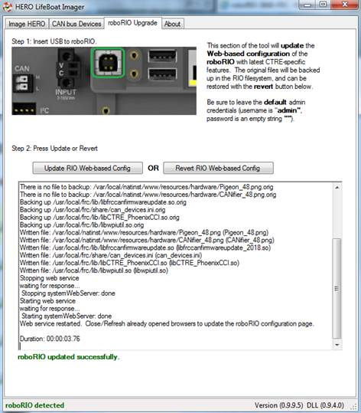
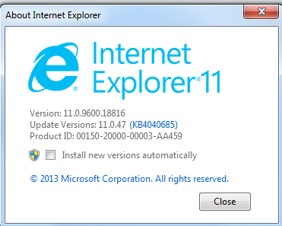
Hero LifeBoat Imager by CTRE

Slide 13
Updating your roboRIO firmware
Enter the address 172.22.11.2 in your browser's address bar and press enter.
2. Click Login. Enter
"admin" in the Username
field and leave the
Password field blank.
3. Click Update Firmware
Notes:
Connect a USB cable from the roboRIO USB Device port to the PC. This requires a USB Type A male
(standard PC end) to Type B male cable (square with 2 cut corners), most commonly found as a
printer USB cable. The driver is for windows is installed during install of latest suite for current year.

Slide 14
Locate Firmware
Browse to Program Files\National Instruments\Shared\Firmware\cRIO\76F2\ Program Files(x86) on 64 bit and select the latest firmware, then click Open (this image shows version 2.0.0f1).
Notes:
Take a look at where the file is located at…Ensure latest suite is installed first.

Slide 15
Updating Firmware On Other Devices
Notes:
Ensure to load firmware for PDB, PCM Modules as well.

Slide 16
Updating Firmware On Talon SRX’s
A Talon SRX can have a device ID from 0 to 62. 63 is reserved for broadcast. If you select an invalid ID you will get an immediate prompt.
Notes:
Ensure to load firmware for PDB, PCM Modules as well.

Slide 17
Updating Firmware On Talon SRX’s
Select the firmware file (*.crf) to flash.
Notes:
Search windows for *.crf

Slide 18
Updating Firmware On Talon SRX’s
Finished Successfully.
Notes:
Search windows for *.crf

Slide 19
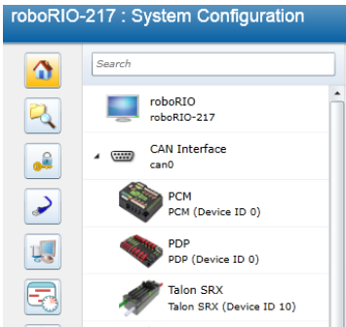
Updating Firmware – PCM / PDP
Must update firmware on these devices
Notes:
Demonstrate on electrical board.

Slide 20
Imaging your roboRIO
Before imaging your roboRIO, you must have completed installation of the the development environment and language updates for the appropriate programming language (C++\Java, LabVIEW) and the FRC Update Suite. You also must have the roboRIO power properly wired to the Power Distribution Panel.

Slide 21
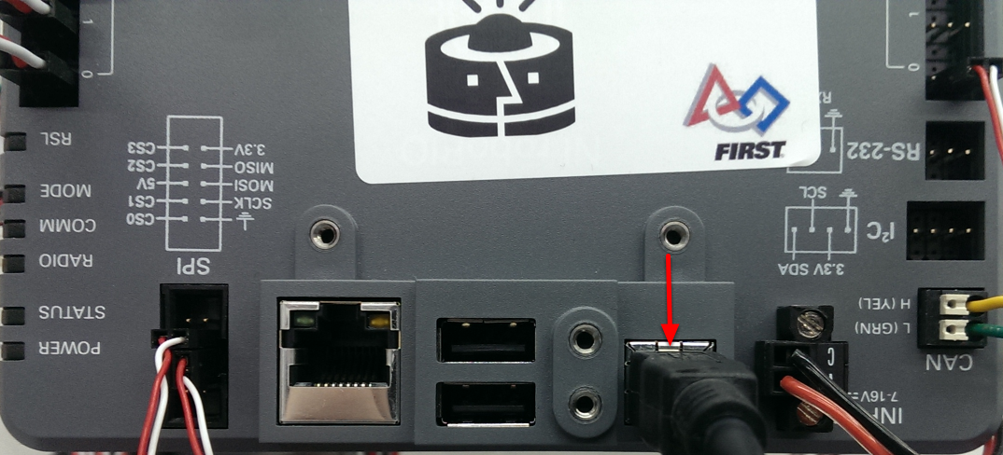
Imaging your roboRIO
Note: The roboRIO should only be imaged via the USB connection. It is not recommended to attempt imaging using the Ethernet connection.

Slide 22
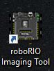
roboRIO Imaging Tool
A desktop shortcut to the roboRIO Imaging Tool has been added, so it's much easier to find and use.

Slide 23
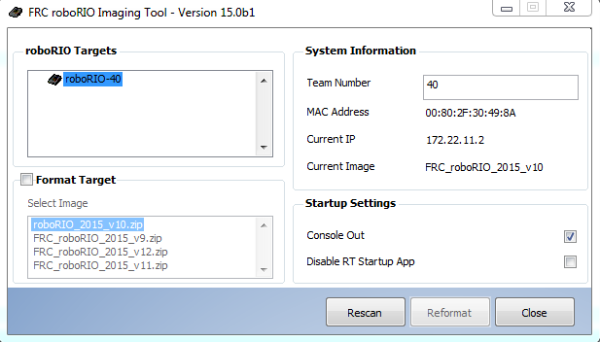
roboRIO Imaging Tool
After launching, the roboRIO Imaging Tool will scan for available roboRIOs and indicate any found in the top left box. The bottom left box will show the available image versions that may be loaded onto the roboRIO. The right hand column contains information and settings for the roboRIO selected in the top left pane.

Slide 24
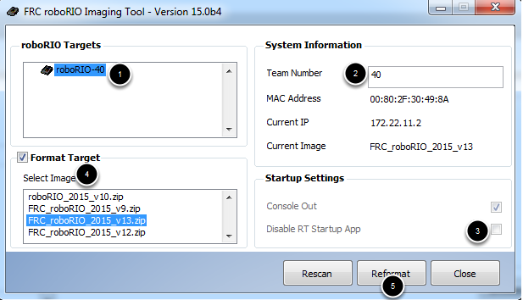
Imaging the roboRIO
Make sure the roboRIO is selected in the top left pane
Enter your team number in the box in the top right
Make sure the Disable RT Startup App box is unchecked in the bottom right
Check the box to Format Target and select the latest image version in the box.
Click Reformat to begin the imaging process.

Slide 25
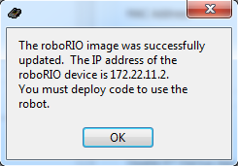
Imaging Complete
When the imaging completes you should see the dialog above. Click Ok, then click the Close button at the bottom right to close the imaging tool. Reboot the roboRIO using the Reset button to have the new team number take effect.
Notes:
Then download JRE or C++ Tool Change or LabView Plug-In’s

Slide 26
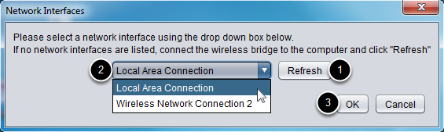
Radio Configuration
If no ethernet interfaces are listed, click "Refresh" to re-scan for available interfaces
Select the interface you want to use from the drop-down list
3. Click "OK"

Slide 27
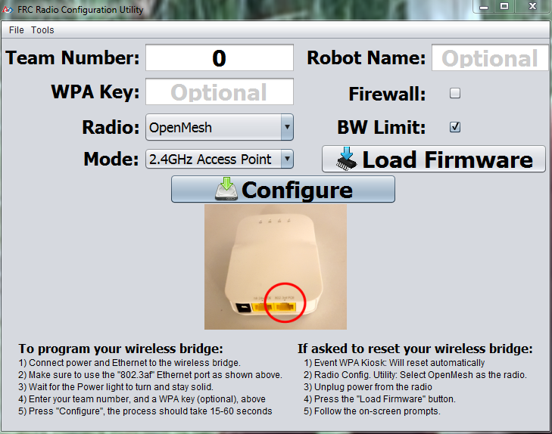
Radio Configuration
1. Select which radio you are configuring using the drop-down list.
2. Select which operating mode you want to configure. For most cases,
the default selection of 2.4GHz Access Point will be sufficient. Note
that the 2.4GHz + 5GHz simultaneous AP mode is not supported by
the D-Link radios.
3. If located outside the USA, select the Country as well to program the
proper country specific restrictions

Slide 28
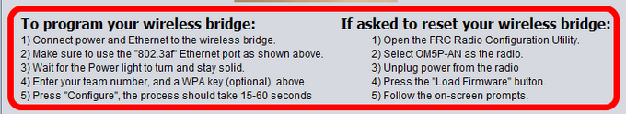
Radio Configuration
Follow the on-screen instructions for preparing your wireless bridge, entering the settings the bridge will be configured with, and starting the configuration process. These on-screen instructions update to match the bridge model and operating mode chosen.

Slide 29
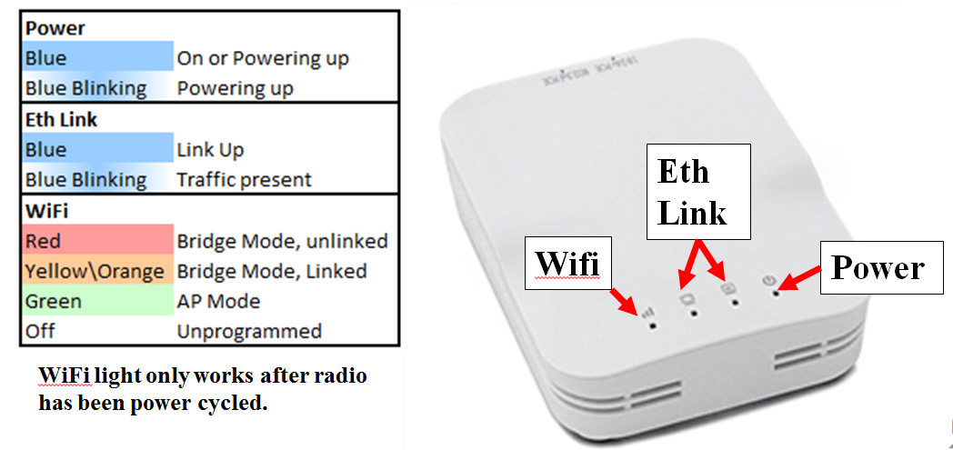
Radio Configuration

Slide 30
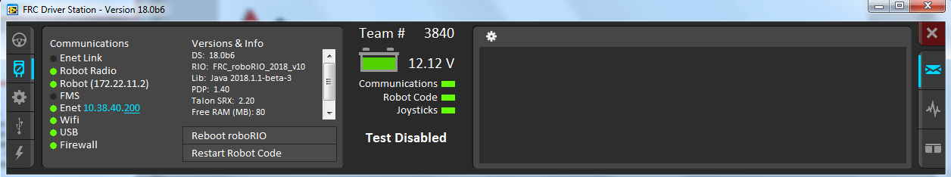
Driver Station
Follow the on-screen instructions for preparing your wireless bridge, entering the settings the bridge will be configured with, and starting the configuration process. These on-screen instructions update to match the bridge model and operating mode chosen.

Slide 31
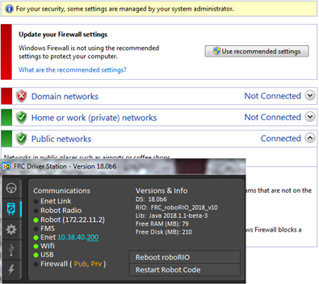
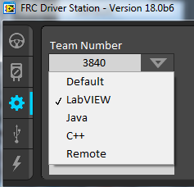
Driver Station
Notes:
The FRC LabVIEW Dashboard is the default dashboard program installed with, and automatically launched by, the FRC Driver Station. The purpose of the Dashboard is to provide feedback about the operation of the robot. The FRC Default Dashboard serves as a an example of the types of feedback
teams may want from their robot.

Slide 32
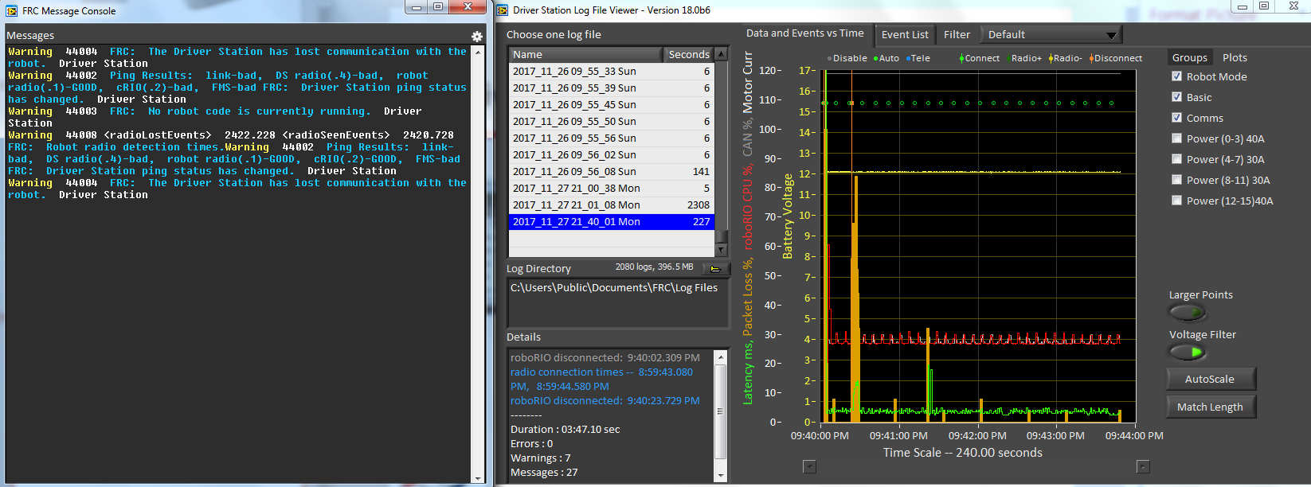
Message Console & Log Files

Slide 33
Driver Station – SmartDashboard
Notes:
The SmartDashboard is an alternate dashboard application written in Java. The SmartDashboard
automatically creates a widget for each variable sent from the Robot sent using the SmartDashboard
class or VIs. These widgets can be configured to a number of preset display types, or users can create
custom extensions in Java.

Slide 34
Smart Dashboard – Live View

Slide 35
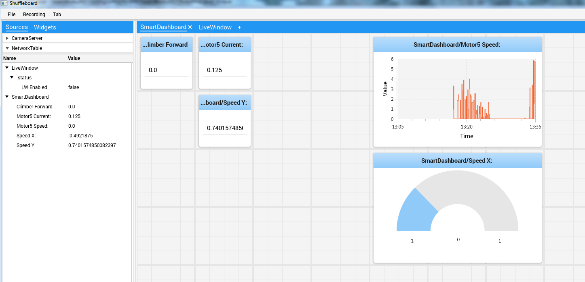
Driver Station – Shuffleboard
Notes:
The SmartDashboard is an alternate dashboard application written in Java. The SmartDashboard
automatically creates a widget for each variable sent from the Robot sent using the SmartDashboard
class or VIs. These widgets can be configured to a number of preset display types, or users can create
custom extensions in Java.

Slide 36
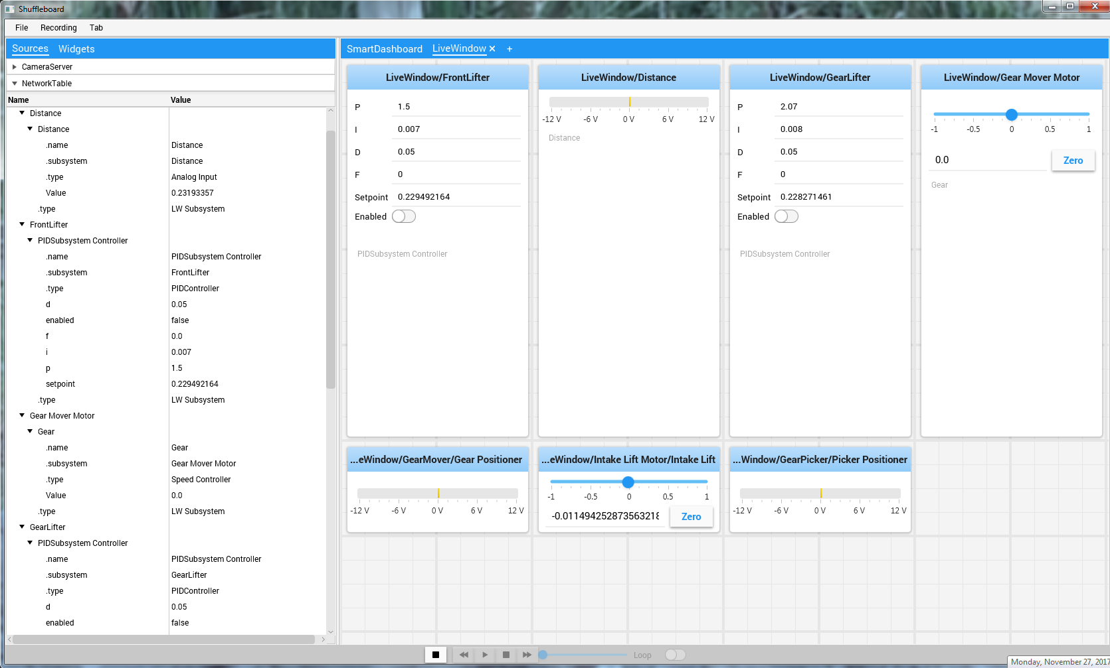
Driver Station – Shuffleboard
Notes:
The SmartDashboard is an alternate dashboard application written in Java. The SmartDashboard
automatically creates a widget for each variable sent from the Robot sent using the SmartDashboard
class or VIs. These widgets can be configured to a number of preset display types, or users can create
custom extensions in Java.

Slide 37
Trouble Shooting
Power
• Green - Power is good
• Amber - Brownout protection
tripped, outputs disabled
• Red - Power fault, check user rails
for short circuit

Slide 38
Trouble Shooting
Status
• On while the controller is booting, then
should turn off
• 2 blinks - Software error, reimage
roboRIO
• 3 blinks - Safe Mode, restart roboRIO,
reimage if not resolved
• 4 blinks - Software crashed twice without
rebooting, reboot roboRIO, reimage if
not resolved
• Constant flash or stays solid on –
Unrecoverable error

Slide 39
Trouble Shooting
Comm
• Off - No Communication
• Red Solid - Communication with DS, but
no user code
• Red Blinking - E-stop
• Green Solid - Good communication with DS

Slide 40
Trouble Shooting
Mode
• Off - Outputs disabled (robot in Disabled,
brown-out, etc.)
• Amber/Orange - Autonomous Enabled
• Green - Teleop Enabled
• Red - Test Enabled

Slide 41
Trouble Shooting - PDP

Slide 42
Trouble Shooting - VRM
The status LEDs on the VRM indicate the state of the two power supplies. If the supply is functioning properly the LED should be lit bright green. If the LED is not lit or is dim, the output may be shorted or drawing too much current.

Slide 43
Trouble Shooting - PCM
Notes:
Solenoid Channel LEDs - These LEDs are lit red if the Solenoid channel is enabled and not lit if it is disabled.
Comp - This is the Compressor LED. This LED is green when the compressor output is active
(compressor is currently on) and off when the compressor output is not active.
Status - The status LED indicates device status as indicated by the two tables above. For more
information on resolving PCM faults see the PCM User Manual. Note that the No CAN Comm fault will not occur only if the device cannot see communicate with any other device, if the PCM and PDP can
communicate with each other, but not the roboRIO you will NOT see a No Can Comm fault.

Slide 44
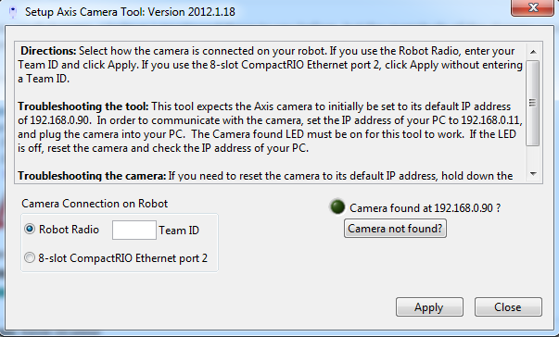
Axis Camera Tool
The Setup Axis Camera utility is a LabVIEW program used to configure an Axis 206, M1011 or M1013 camera for use on the robot.

Slide 45
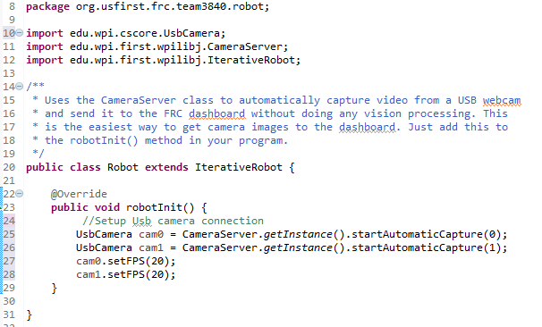
Using the camera server on the roboRIO
The following program gets a CameraServer instance and starts automatic capture of a USB camera like the Microsoft LifeCam that is connected to the roboRIO.

Slide 46
Tips and Good Practices: Reliability!
Most important consideration, bar none.
Three most important parts of a robot are, famously, “controls, controls and controls.”
Good practices:
Continuous to read weekly updates from FIRST
Document IP Address and configuration settings
Backup and store offline of main computer

Slide 47
Resources
Getting Started with the 2017 Control System
https://wpilib.screenstepslive.com/s/4485/m/13503
Configuring an Axis Camera
https://wpilib.screenstepslive.com/s/4485/m/24194/l/144985-configuring-an-axis-camera?id=144985-configuring-an-axis-camera
FRC Driver Station Powered by NI LabVIEW
http://wpilib.screenstepslive.com/s/4485/m/24192/l/144976?data-resolve-url=true&data-manual-id=24192

